Slide 1
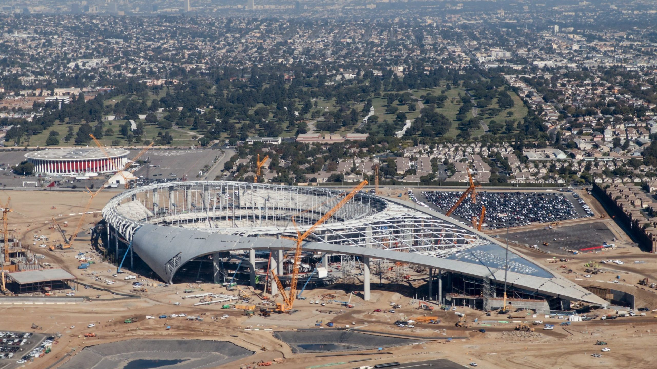
Who Actually Pays For NFL Stadiums?
Mike Messina

Slide 2
Some Background
Since 1997, NFL stadiums on average have cost $525.4 million with that number increasing exponentially in recent years.
Stadiums built between 1972 and 2009 cost on average $466.83 million
Stadiums built since 2010 cost on average $1.733 BILLION
Most of the time, NFL Owners will seek to have a portion/the full cost of their new stadium paid for by the taxpaying public.
On average, the public will be on the hook for 58% of the stadium cost. Given the average stadium costs $525.4 million, this is $304.7 million that the taxpaying public will be paying for whether or not they are even a fan of the team or use the services of the stadium.
Couldn’t this taxpayer money be used in more important ways?

Slide 3
Aims
Is there any relation to the socioeconomic area a stadium is built to how much of the costs the locals must bear?
Are stadium costs balanced across less economically rich areas?
Are certain ethnic groups unfairly paying for these stadiums simply because they live in an area deemed “developable”?
These are some of the questions I’ll try to answer.

Slide 4
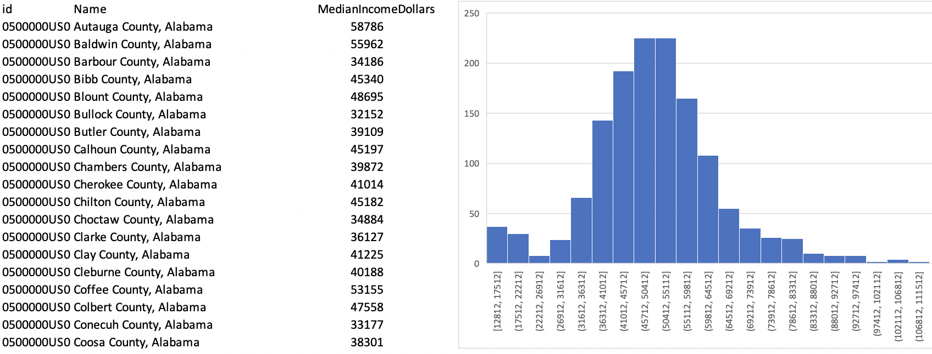
Socioeconomic Data
Sample of the 2018 Median Incomes of every county in the United States*.
Data is normally distributed which can be illustrated nicely in a cartograph using three different classes (low, medium, high).
Id is formatted as a GEOID which can be easily joined to other tables that include US county data.
US Bureau of Labor Statistics*

Slide 5
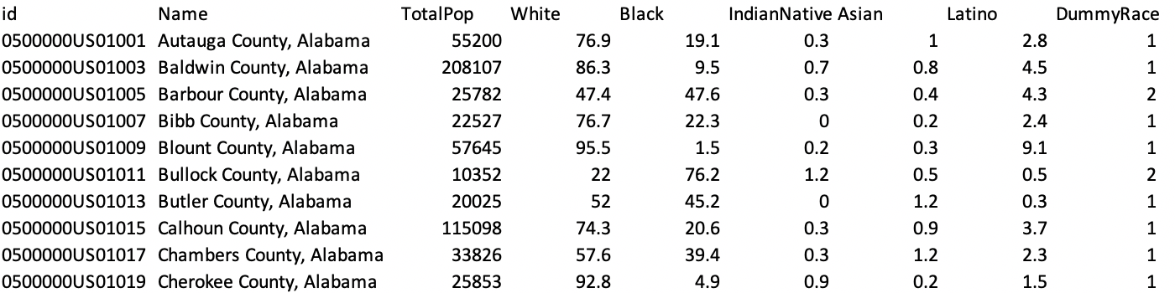
Racial Demographic Data
Sample of the normalized 2018 US Census data*.
Dummy variables were created to represent the majority race category of each county:
1 - White
2 - Black
3 - Native American
4 - Latino
US Census*

Slide 6
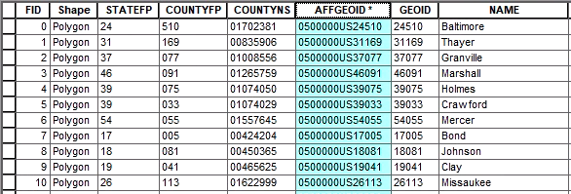
Geographic Data
County geographic boundary data from US Census*.
AFFGEOID column used as foreign key to join income and racial data tables.
US Census*

Slide 7
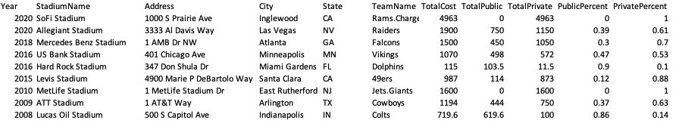
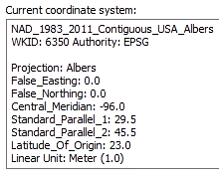
NFL Stadium Cost Data
Sample of NFL stadium cost data*.
Addresses were geocoded in ArcMap to generate coordinate data for each stadium.
NAD 1983-2011 Contiguous USA Albers was used as the map projection since we’re just focusing on the continental United States.
Conventions, Sports, and Leisure*
Stadiumsofprofootball.com*
Figures in Millions

Slide 8
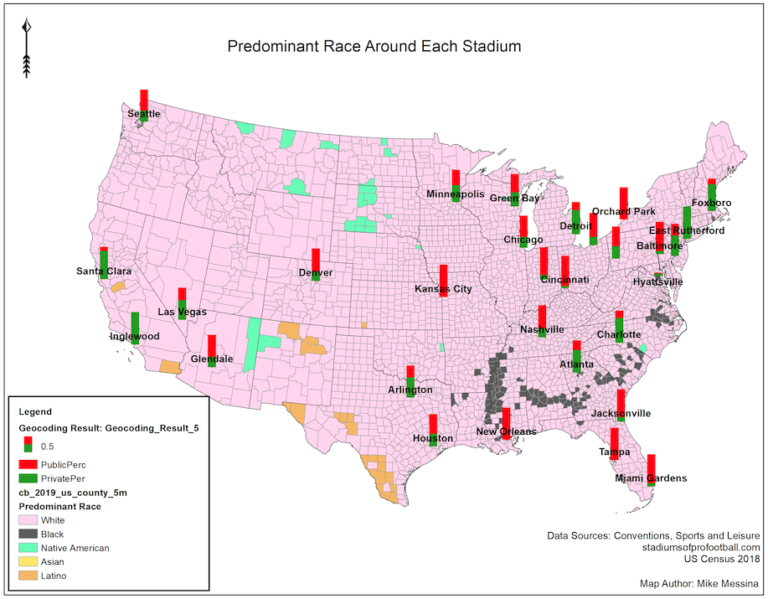
Since most US counties are predominately white, our first map doesn’t show too much in the way of if any ethnic group are associated with paying for NFL stadiums.
Stadiums in the South close to predominantly black counties (Jacksonville and New Orleans) are all shown to have a large percentage of public stadium funding over private funding.

Slide 9
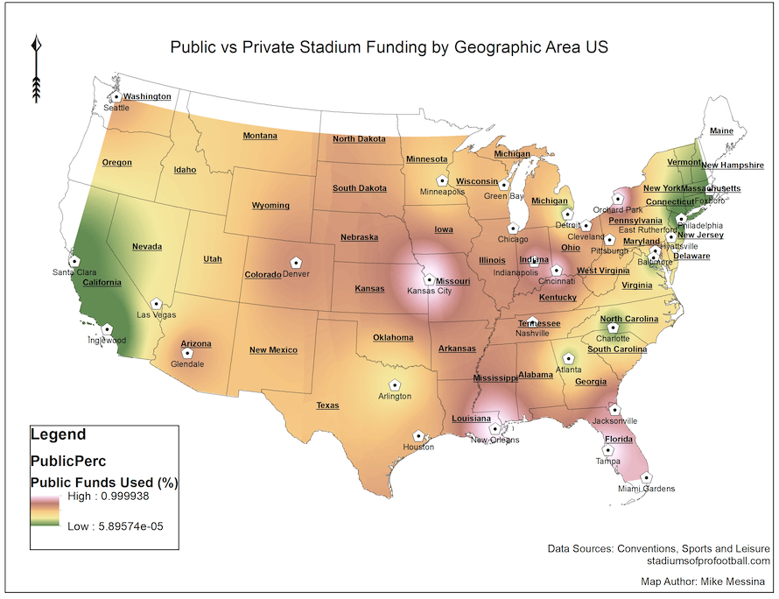
Inverse Distance Weighting (IDW) of the proportion of Public vs. Private funding for each stadium.
IDW is used to smoothly represent how regions of the US are paying for NFL stadiums.
Stadiums located on the NE and SW coast (democratic areas) are shown to more often pay for the stadiums with private money than public taxpayer money.
Stadiums located in the South and Midwest are more likely to be funded with public money.

Slide 10
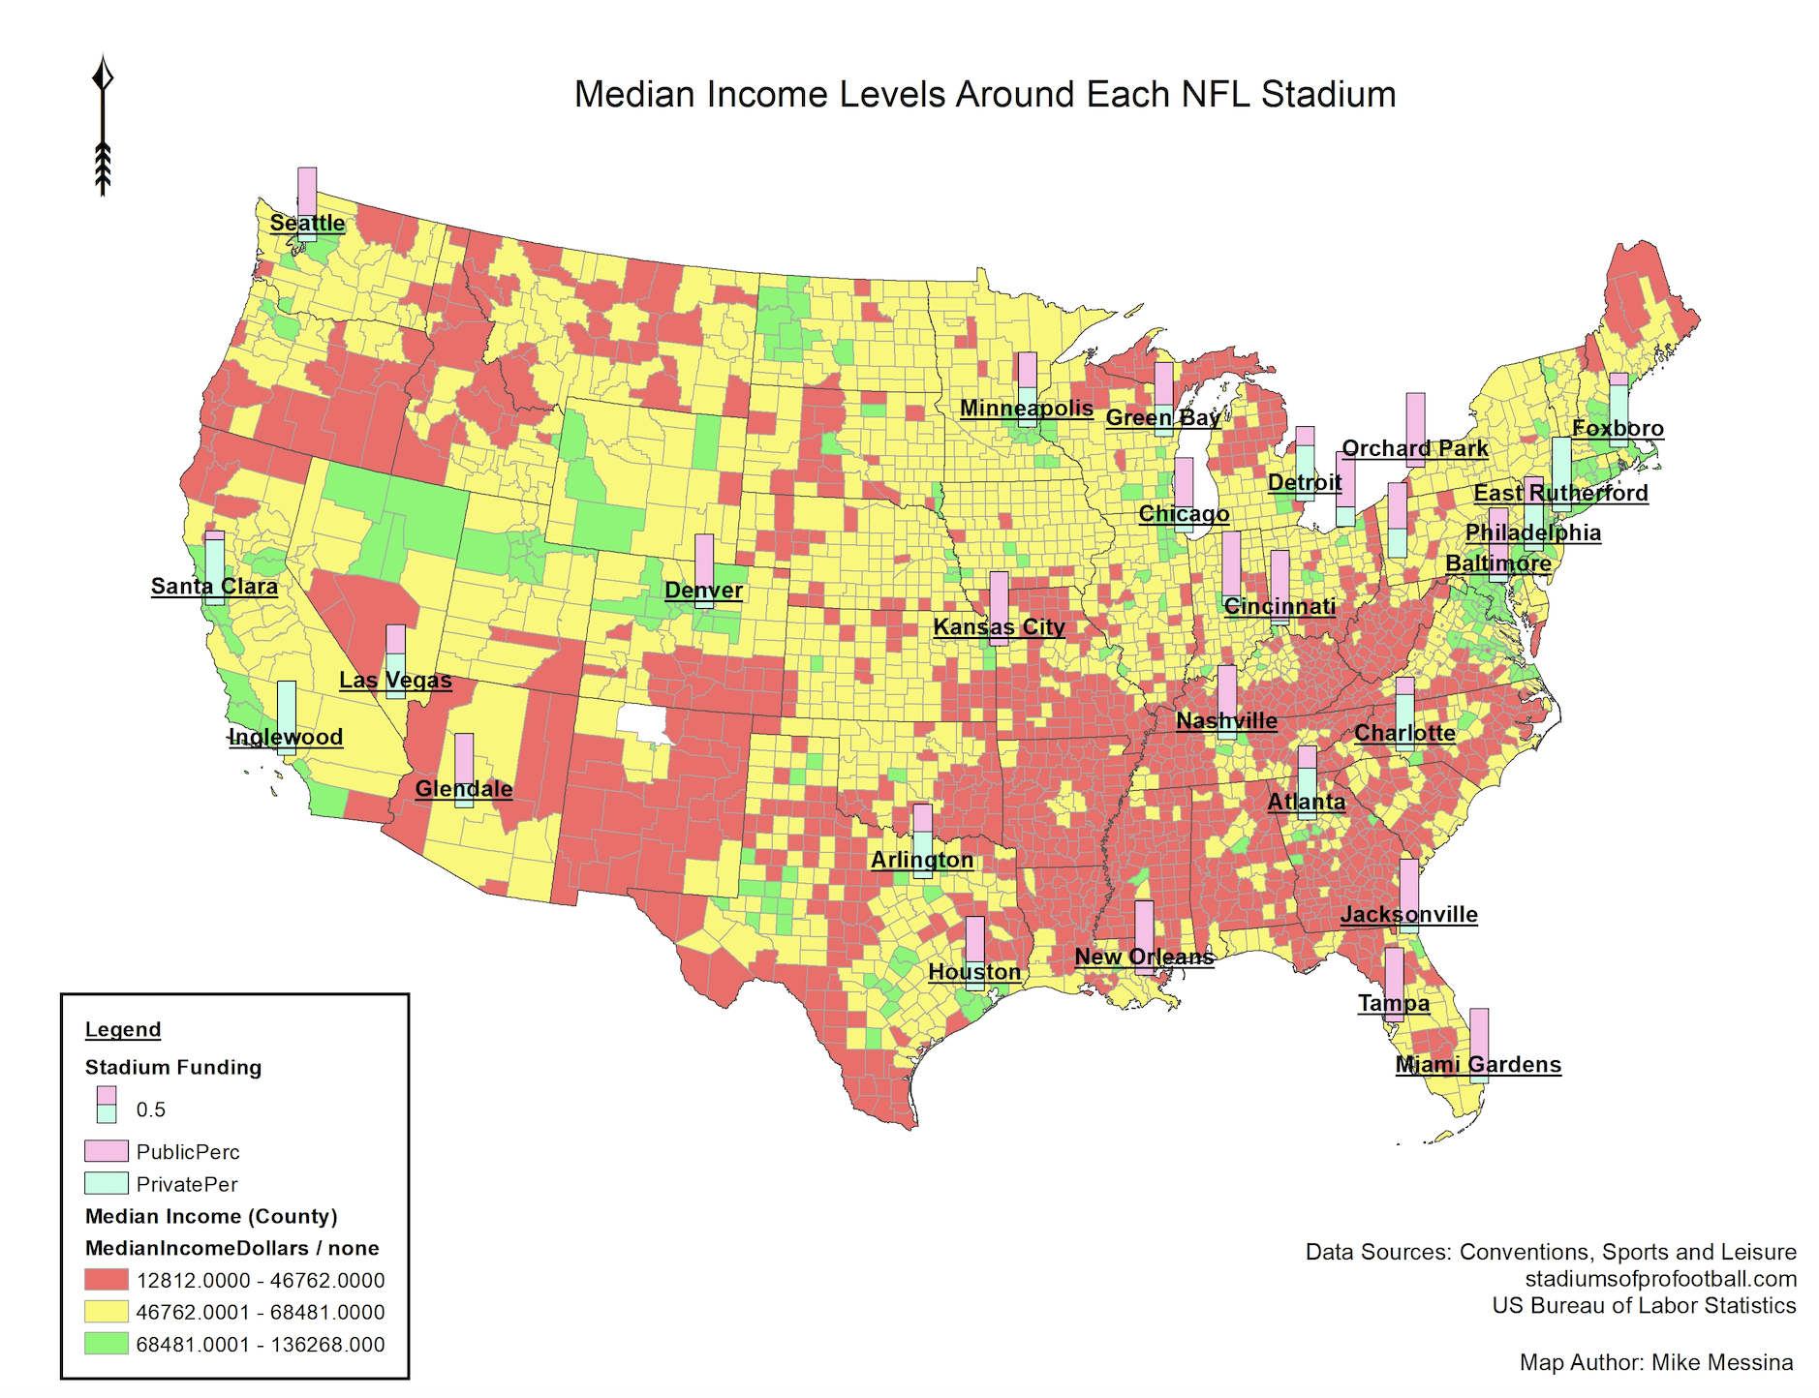
Median County income levels are shown in three classes (low, medium, high) which we can associate with each stadium location and proportion of funding.
The high public funded stadiums in the south actually appear to be directly surrounded by medium income counties and not low income counties.
Stadiums in Santa Clara, Inglewood, and Foxboro are surrounded by higher income counties, yet these stadiums were funded predominantly by private money.
The stadium in Denver appears to contrast the most by being surrounded by high income counties yet being funded almost exclusively by public money.

Slide 11
Takeaways
While it’s difficult to quantify if any area or group of people are unfairly paying for these expensive NFL stadiums, we can see a direct relation to stadiums in the southern US being paid for by public money more so than private money.
These areas also tend to be lower income but we can see that the stadium itself is actually located in a more moderate income level county.
It’s also clear from these maps that higher income areas are more likely to use private funding. It’s inconclusive if this is politically motivated or what could be causing this to be the case.

